Slide 1


AQA A-LEVEL PSYCHOLOGY
PAPER 3- SCHIZOPHRENIA
# | CONTENT | COMPLETED?
1 | CLASSIFICATION OF SCHIZOPHRENIA, INCLUDING SYMPTOMS
2 | RELIABILITY AND VALIDITY OF DIAGNOSIS AND CLASSIFICATION
3 | BIOLOGICAL EXPLANATIONS FOR SCHIZOPHRENIA
4 | BIOLOGICAL TREATMENT FOR SCHIZOPHRENIA: DRUG THERAPY
5 | PSYCHOLOGICAL EXPLANATIONS FOR SCHIZOPHRENIA
6 | PSYCHOLOGICAL TREATMENT FOR SCHIZOPHRENIA: CBT
7 | PSYCHOLOGICAL TREATMENT FOR SCHIZOPHRENIA: FAMILY THERAPY
8 | TOKEN ECONOMY PROGRAMMES AND THE MANAGEMENT OF SCHIZOPHRENIA
9 | AN INTERACTIONIST APPROACH TO SCHIZOPHRENIA
NAME: ____________________________

Slide 2
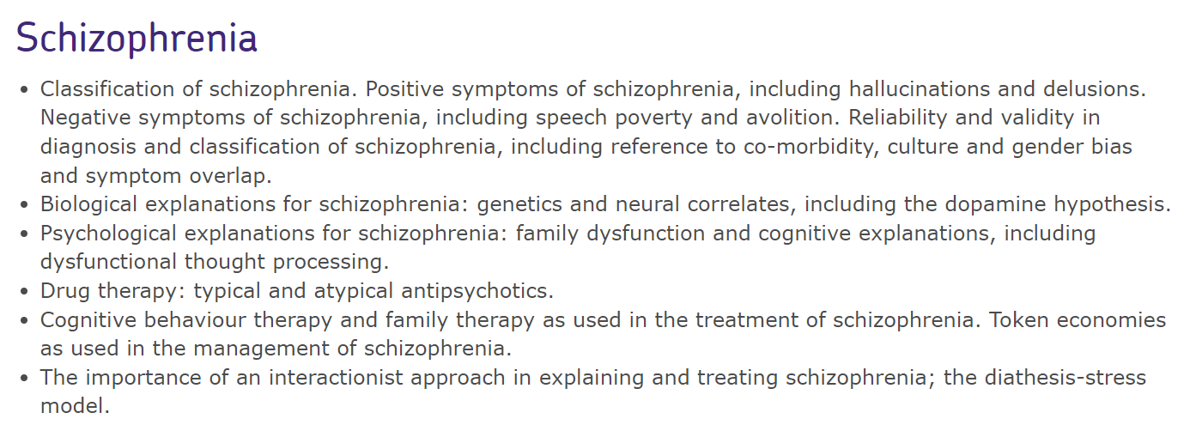
HOW TO USE THIS BOOKLET
Instructions:
Example questions are given in the style of real exam questions. Some sentence starters are given.
Your teacher will tell you each week which pages you need to complete.
This booklet will be checked weekly by your class teacher.
DO NOT TREAT THIS AS JUST SOMETHING YOU HAVE TO DO. THIS WORKBOOK HAS BEEN CREATED WITH THE SPECIFIC PURPOSE OF IMPROVING YOUR UNDERSTANDING OF THIS TOPIC.
We have answers to questions. These will be provided once you have completed it.
Most sections have research methods practice too.
THIS BOOKLET DOES NOT REPLACE CLASS NOTES, IT IS FOR CONSOLIDATION AND EXAM PRACTICE
SPECIFICATION: Check for key terms

Slide 3
1
CLASSIFICATION OF SCHIZOPHRENIA
What the spec says… Classification of schizophrenia. Positive symptoms of schizophrenia, including hallucinations and delusions. Negative symptoms of schizophrenia, including speech poverty and avolition.
1 | Which one of the following is not a symptom of schizophrenia? Tick one box only. | 1 mark (AO1)
A | Auditory hallucinations
B | Speech poverty
C | Rumination syndrome
D | Delusions
2 | Distinguish between positive and negative symptoms of schizophrenia. | 4 marks (AO1)
A positive symptom of schizophrenia is one that__________________________________ ______________________________________________________________________________________________________________________________________For example __________________________________________________________ ___________________________________________________________________ ___________________________________________________________________ A negative symptom of schizophrenia is one that_________________________________ ______________________________________________________________________________________________________________________________________For example __________________________________________________________ ___________________________________________________________________ ___________________________________________________________________

Slide 4
Sample answer
Q: Explain anhedonia as a symptom of schizophrenia. (AO1 = 2 marks)
Anhedonia is a negative symptom, characterised by the inability to experience physical pleasures such as food or bodily contact (physical anhedonia) or the inability to experience pleasure from interpersonal situations such as interacting with other people (social anhedonia).
3 | Outline one positive symptom and one negative symptom of schizophrenia. | 4 marks (AO1)
Hallucinations are a positive symptom characterised by_____________________________ _________________________________________________________________________________________________________________________________________________________________________________________________________Avolition is a negative symptom characterised by_________________________________ ___________________________________________________________________ ___________________________________________________________________ ___________________________________________________________________
RESEARCH METHODS ALERT
4 | Professor Caroline Smith was interested in the ways in which the DSM has changed its views on schizophrenia since it was introduced in 1952. She looked at all the versions up to DSM-5, which was introduced in 2013. She wrote an article on her findings and submitted it for publication in a peer-reviewed journal. Later, she wrote a book which was published in London. It was called ‘How beliefs about schizophrenia have changed’, and was published by The Psychiatric Press in 2018.
Professor Smith collected secondary data in her study. Explain what is meant by ‘secondary data’. ____________________________________________________________________________________________________________________ ____________________________________________________________________________________________________________________ |  | 2 marks (AO1)

Slide 5
(b) Outline the purpose of the abstract section in a scientific report. ____________________________________________________________________________________________________________________ ____________________________________________________________________________________________________________________ | 2 marks (AO1)
(c) Professor Smith’s article underwent a peer review process. Briefly explain one reason why it is important for research to undergo this process. ____________________________________________________________________________________________________________________ ____________________________________________________________________________________________________________________ | 2 marks (AO1)
(d) Write the full reference for Professor Smith’s book as it should appear in the reference section of another researcher’s report. ____________________________________________________________________________________________________________________ ____________________________________________________________________________________________________________________ | 2 marks (AO2)
2 RELIABILITY AND VALIDITY IN DIAGNOSIS AND CLASSIFICATION
What the spec says… Reliability and validity in diagnosis and classification of schizophrenia, including reference to co-morbidity, culture and gender bias and symptom overlap.
1 | Which one of the following is the best definition of co-morbidity as the term is used in the diagnosis/classification of schizophrenia? Tick one box only. | 1 mark (AO1)
A | The consistency of diagnoses made by two independent clinicians.
B | The occurrence of two or more symptoms in a person diagnosed as schizophrenic.
C | The extent to which two or more people diagnosed as schizophrenic share the same symptoms.
D | The extent to which two or more conditions occur simultaneously in a person

Slide 6
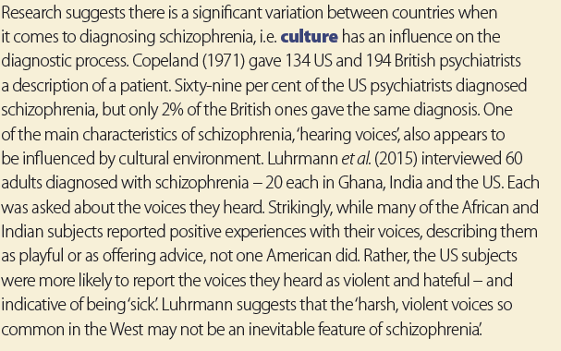
2 | Outline the role of culture in the diagnosis and/or classification of schizophrenia. | 3 marks (AO1)
There is a significant variation between countries in the diagnosis of schizophrenia. For example, Copeland _____________________________________________________ ______________________________________________________________________________________________________________________________________Copeland found that _____________________________________________________ ___________________________________________________________________ ___________________________________________________________________
Forgot what Copeland found? Read this →
3 | Explain the difference between symptom overlap and co-morbidity in the classification and/or diagnosis of schizophrenia. | 3 marks (AO1)
Symptom overlap is where_________________________________________________ ___________________________________________________________________For example,__________________________________________________________ ___________________________________________________________________ However, co-morbidity is _________________________________________________ ___________________________________________________________________For example,__________________________________________________________ ___________________________________________________________________

Slide 7
RESEARCH METHODS ALERT
4 | A researcher was interested in finding out whether there was gender bias in the diagnosis and/or classification of schizophrenia. He showed transcripts of clinical interviews to a sample of 60 psychiatrists, asking them whether they would diagnose schizophrenia on the basis of these transcripts. One group of psychiatrists was told that all the interviews were with males, a second group was told that they were with females and a third group was told nothing about the gender of the individuals interviewed.
What is the aim of this study? ____________________________________________________________________________________________________________________ __________________________________________________________ |  | 2 marks (AO2)
(b) Outline the difference between an aim and a hypothesis. ____________________________________________________________________________________________________________________ __________________________________________________________ |  | 2 marks (AO2)
(c) Identify the independent and dependent variables in this study. ____________________________________________________________________________________________________________________ __________________________________________________________ |  | 2 marks (AO2)
(d) Write a non-directional hypothesis for this study. ____________________________________________________________________________________________________________________ __________________________________________________________ |  | 2 marks (AO1)
(e) The researcher decided to carry out a pilot study first. Briefly explain what a pilot study is and why it would be appropriate here. ____________________________________________________________________________________________________________________ __________________________________________________________ ____________________________________________________________________________________________________________________ |  | 3 marks (AO1 = 1; AO2 = 2)

Slide 8
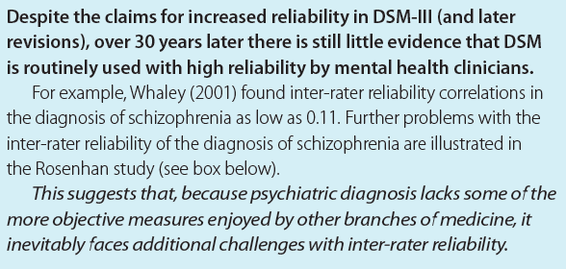
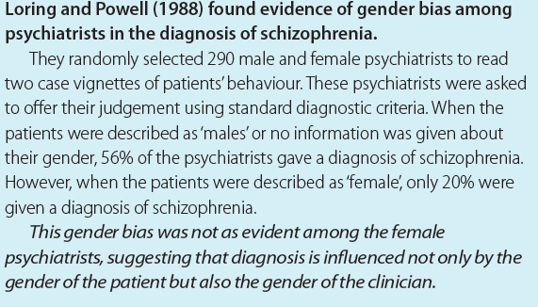
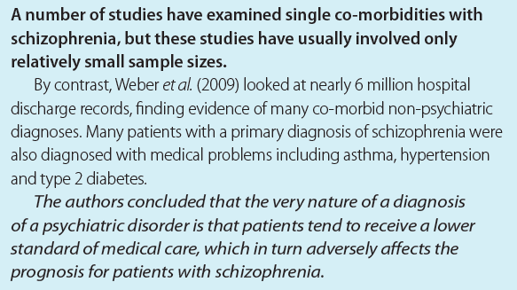
(f) The researcher also wanted to assess inter-observer reliability within the three groups. Explain how he could do this. ____________________________________________________________________________________________________________________ __________________________________________________________ ____________________________________________________________________________________________________________________ __________________________________________________________ | 3 marks (AO2)
5 | Finn and Ferdi were discussing issues in the diagnosis and classification of schizophrenia. ‘A diagnosis can be reliable without being valid’, said Ferdi. ‘No,’ said Finn, ‘it’s the other way round. A diagnosis can be valid without being reliable.’ Distinguish between reliability and validity, and explain which of Finn or Ferdi’s view is correct. | 4 marks (AO1 = 2; AO2 = 2)
Reliability in diagnosis is __________________________________________________ ____________________________________________________________________However, validity of diagnosis is _____________________________________________ ____________________________________________________________________ Finn’s view is correct/not correct because ______________________________________ ____________________________________________________________________Ferdi’s view is correct/not correct because _____________________________________ ____________________________________________________________________
You may need this research to answer the essay question on the next page.

Slide 9
6 | Outline and evaluate issues associated with the classification and diagnosis of schizophrenia. | 16 marks (AO1 = 6; AO3 = 10)
The suggested paragraph starters below will help form your answer: One issue is the reliability of diagnosis. This is… (AO1) Another issue is the validity of diagnosis. This is… (AO1) Co-morbidity and symptom overlap are also issues in the classification and diagnosis of schizophrenia. Co-morbidity is… (AO1) Symptom overlap is… (AO1) There is also a cultural bias when schizophrenia is being diagnosed… (AO1) There is gender bias in schizophrenia diagnosis… (AO1) There is research support for the idea that there are cultural differences in schizophrenia diagnosis. For example, the prognosis for members of ethnic minority groups… (AO3) There is also research support for gender bias in diagnosis. For example, Loring and Powell found… (AO3) One issue with diagnosing schizophrenia is inter-observer reliability. For example. Waley found… (AO3) One problem with co-morbidity is that it may have negative consequences for people diagnosed with schizophrenia. For example, Weber et al … (AO3) A final problem with diagnosing schizophrenia is… (AO3) ______________________________________________________________________________________________________________________________________________________________________ ______________________________________________________________________________________________________________________________________________________________________ ___________________________________________________________________________________ ______________________________________________________________________________________________________________________________________________________________________ ______________________________________________________________________________________________________________________________________________________________________ ___________________________________________________________________________________ ______________________________________________________________________________________________________________________________________________________________________ ______________________________________________________________________________________________________________________________________________________________________ ___________________________________________________________________________________ ______________________________________________________________________________________________________________________________________________________________________ ______________________________________________________________________________________________________________________________________________________________________ ___________________________________________________________________________________
Essay tip: For a 16 mark question you should aim for 5 evaluation points or 4 if you are discussing them in more detail.

Slide 10
______________________________________________________________________________________________________________________________________________________________________ ______________________________________________________________________________________________________________________________________________________________________ ___________________________________________________________________________________ ______________________________________________________________________________________________________________________________________________________________________ ______________________________________________________________________________________________________________________________________________________________________ ___________________________________________________________________________________ ______________________________________________________________________________________________________________________________________________________________________ ______________________________________________________________________________________________________________________________________________________________________ ___________________________________________________________________________________ ______________________________________________________________________________________________________________________________________________________________________ ______________________________________________________________________________________________________________________________________________________________________ ___________________________________________________________________________________ ______________________________________________________________________________________________________________________________________________________________________ ______________________________________________________________________________________________________________________________________________________________________ ___________________________________________________________________________________ ______________________________________________________________________________________________________________________________________________________________________ ______________________________________________________________________________________________________________________________________________________________________ ___________________________________________________________________________________ ______________________________________________________________________________________________________________________________________________________________________ ______________________________________________________________________________________________________________________________________________________________________

Slide 11
______________________________________________________________________________________________________________________________________________________________________ ______________________________________________________________________________________________________________________________________________________________________ ___________________________________________________________________________________ ______________________________________________________________________________________________________________________________________________________________________ ______________________________________________________________________________________________________________________________________________________________________ ___________________________________________________________________________________ ______________________________________________________________________________________________________________________________________________________________________ ______________________________________________________________________________________________________________________________________________________________________ ___________________________________________________________________________________ ______________________________________________________________________________________________________________________________________________________________________ ______________________________________________________________________________________________________________________________________________________________________ ___________________________________________________________________________________ ______________________________________________________________________________________________________________________________________________________________________ ______________________________________________________________________________________________________________________________________________________________________ ___________________________________________________________________________________ ______________________________________________________________________________________________________________________________________________________________________ ______________________________________________________________________________________________________________________________________________________________________ ___________________________________________________________________________________ ______________________________________________________________________________________________________________________________________________________________________ ______________________________________________________________________________________________________________________________________________________________________

Slide 12
3
BIOLOGICAL EXPLANATIONS FOR SCHIZOPHRENIA
What the spec says… Biological explanations for schizophrenia: genetics and neural correlates, including the dopamine hypothesis.
1 | Which one of the following best describes the dopamine hypothesis of schizophrenia? Tick one box only. | 1 mark (AO1)
A | The positive symptoms of schizophrenia are caused by a deficiency of dopamine in certain brain regions.
B | An excess of dopamine is associated with both the positive and negative symptoms of schizophrenia.
C | The positive symptoms of schizophrenia are caused by an excess of dopamine in certain brain regions.
D | The negative symptoms of schizophrenia are caused by an excess of dopamine in certain brain regions.
2 | Outline one study that has investigated the role of genetics in schizophrenia. | 3 marks (AO1)
Tienari et al. studied 164 adoptees whose biological mothers has been diagnosed with schizophrenia, and 197 control adoptees whose__________________________________ ______________________________________________________________________________________________________________________________________They found that________________________________________________________ ___________________________________________________________________ This shows that________________________________________________________ ___________________________________________________________________
3 | In several research studies, the concordance rates for schizophrenia have been shown to be several times higher for monozygotic than for dizygotic twins, even though twins are typically raised in the same environments. Using your knowledge of biological explanations for schizophrenia, outline why this findings can be taken as support for the view that genetic factors play a role in schizophrenia. answer on the next page | 4 marks (AO1 = 2; AO2 = 2)

Slide 13
Genetic explanations for schizophrenia claim that________________________________ ___________________________________________________________________A concordance rate is ___________________________________________________ ___________________________________________________________________ If a concordance rate for monozygotic twins is higher than for dizygotic twins this means that ___________________________________________________________________ ___________________________________________________________________ Therefore, this finding ___________________________________________________ ___________________________________________________________________
4 | Outline and evaluate the dopamine hypothesis as an explanation for schizophrenia. | 8 marks (AO1 = 3; AO3 = 5)
The original dopamine hypothesis states_______________________________________ ______________________________________________________________________________________________________________________________________The updated dopamine hypothesis proposes____________________________________ ___________________________________________________________________ ___________________________________________________________________ Supporting evidence for the role of dopamine comes from the use of antipsychotics _________ ___________________________________________________________________ ___________________________________________________________________ ___________________________________________________________________ ___________________________________________________________________ ___________________________________________________________________ However, the dopamine hypothesis is challenged because of evidence that shows __________ ___________________________________________________________________ ___________________________________________________________________ Continued on next page

Slide 14
___________________________________________________________________ ___________________________________________________________________A further criticism is _____________________________________________________ ___________________________________________________________________ ___________________________________________________________________ ___________________________________________________________________ ___________________________________________________________________ ___________________________________________________________________
5 | Outline and evaluate biological explanations for schizophrenia. | 16 marks (AO1 = 6; AO3 = 10)
The suggested paragraph starters below will help form your answer: The biological explanation for schizophrenia says that genetic factors may be involved. Twin studies have found… (AO1) The biological explanation also includes the dopamine hypothesis. This says that… (AO1) One limitation of twin studies is that a higher concordance rate may be the result of environmental, as well as genetic, factors… (AO3) There is research support for the dopamine hypothesis. For example, drug therapy… (AO3) One problem with the dopamine hypothesis is that it has been challenged. For example, … (AO3) A second problem with the dopamine hypothesis is… (AO3) (Don’t forget to include your own evaluation points) ______________________________________________________________________________________________________________________________________________________________________ ______________________________________________________________________________________________________________________________________________________________________ ___________________________________________________________________________________ ______________________________________________________________________________________________________________________________________________________________________ ______________________________________________________________________________________________________________________________________________________________________ ___________________________________________________________________________________ ______________________________________________________________________________________________________________________________________________________________________

Slide 15
______________________________________________________________________________________________________________________________________________________________________ ______________________________________________________________________________________________________________________________________________________________________ ___________________________________________________________________________________ ______________________________________________________________________________________________________________________________________________________________________ ______________________________________________________________________________________________________________________________________________________________________ ___________________________________________________________________________________ ______________________________________________________________________________________________________________________________________________________________________ ______________________________________________________________________________________________________________________________________________________________________ ___________________________________________________________________________________ ______________________________________________________________________________________________________________________________________________________________________ ______________________________________________________________________________________________________________________________________________________________________ ___________________________________________________________________________________ ______________________________________________________________________________________________________________________________________________________________________ ______________________________________________________________________________________________________________________________________________________________________ ___________________________________________________________________________________ ______________________________________________________________________________________________________________________________________________________________________ ______________________________________________________________________________________________________________________________________________________________________ ___________________________________________________________________________________ ______________________________________________________________________________________________________________________________________________________________________ ______________________________________________________________________________________________________________________________________________________________________

Slide 16
______________________________________________________________________________________________________________________________________________________________________ ______________________________________________________________________________________________________________________________________________________________________ ___________________________________________________________________________________ ______________________________________________________________________________________________________________________________________________________________________ ______________________________________________________________________________________________________________________________________________________________________ ___________________________________________________________________________________ ______________________________________________________________________________________________________________________________________________________________________ ______________________________________________________________________________________________________________________________________________________________________ ___________________________________________________________________________________ ______________________________________________________________________________________________________________________________________________________________________ ______________________________________________________________________________________________________________________________________________________________________ ___________________________________________________________________________________ ______________________________________________________________________________________________________________________________________________________________________ ______________________________________________________________________________________________________________________________________________________________________ ___________________________________________________________________________________ ______________________________________________________________________________________________________________________________________________________________________ ______________________________________________________________________________________________________________________________________________________________________ ___________________________________________________________________________________ ______________________________________________________________________________________________________________________________________________________________________ ______________________________________________________________________________________________________________________________________________________________________

Slide 17
4
BIOLOGICAL TREATMENT: DRUG THERAPY
What the spec says… Drug therapy: typical and atypical antipsychotics
1 | Which one of the following is an ac curate statement of how typical antipsychotic drugs treat schizophrenia. Tick one box only. | 1 mark (AO1)
A | Typical antipsychotics cause an increase in dopamine’s effects.
B | Typical antipsychotics cause a reduction in dopamine’s effects.
C | Typical antipsychotics cause an increase in dopamine’s and serotonin’s effects.
D | Typical antipsychotics cause a reduction in dopamine’s and serotonin’s effects.
2 | Evaluate the use of antipsychotic drugs as a therapy for schizophrenia. | 4 marks (AO3)
One limitation of drug therapy is that drugs have side effects. For example, typical antipsychotics can cause ___________________________________________________ ___________________________________________________________________ If patients keep using them then ____________________________________________ ___________________________________________________________________ ___________________________________________________________________ This means that __________________________________________________________ ___________________________________________________________________On the other hand, _____________________________________________________ ___________________________________________________________________ ___________________________________________________________________ ___________________________________________________________________ ___________________________________________________________________ ___________________________________________________________________

Slide 18
RESEARCH METHODS ALERT
3 | Researchers carried out a study of the effectiveness of antipsychotics in the treatment of schizophrenia. They advertised in the psychiatric ward of a local hospital, asking for volunteers to take part in the study. This led to a sample of 32 individuals who were being treated using antipsychotics. Half of these individuals continued to take their regular dosage of the antipsychotic for three months, whereas the other half were given a placebo. At the end of the study, both groups were assessed by a psychiatrist for the severity of their symptoms.
Write a suitable directional hypothesis for this study. ____________________________________________________________________________________________________________________ __________________________________________________________ ____________________________________________________________________________________________________________________ |  | 3 marks (AO2)
(b) What type of sample was used in this study? Give one limitation of this method of sampling. ____________________________________________________________________________________________________________________ __________________________________________________________ ____________________________________________________________________________________________________________________ __________________________________________________________ |  | 3 marks (AO2 = 1; AO3 = 2)
(c) Outline one way in which the researchers could have minimised the risk of bias when allocating individuals to either the antipsychotic or placebo group. ____________________________________________________________________________________________________________________ __________________________________________________________ __________________________________________________________ |  | 2 marks (AO2)
(d) What is meant by investigator effects? Explain why investigator effects may have been an issue in this study. ____________________________________________________________________________________________________________________ __________________________________________________________ Continued on next page |  | 4 marks (AO1 = 2; AO2 = 2)

Slide 19
(e) Outline one ethical issue that might have arisen in the study. ____________________________________________________________________________________________________________________ __________________________________________________________ __________________________________________________________ | 2 marks (AO2)
4 | Matt is a schizophrenic who rarely talks and typically lies in his bed for much of the day. His medical records show that he has been receiving typical antipsychotic treatment for years. A clinician believes that Matt might benefit from treatment using an atypical antipsychotic, and suggests a change to Matt’s medication. | 4 marks (AO2)
Typical antipsychotics work by ________________________________________________ ____________________________________________________________________ Unfortunately, one side effect of the drugs Matt is taking is ___________________________ ____________________________________________________________________ One strength of atypical antipsychotic drugs Matt’s clinician wants him to change to is ________ _______________________________________________________________________This means that ________________________________________________________ ____________________________________________________________________
5 | Outline the use of atypical antipsychotics in the treatment of schizophrenia and give one strength of this type of treatment. | 6 marks (AO1 = 3; AO3 = 3)
Atypical antipsychotics aim to ________________________________________________ ____________________________________________________________________ ____________________________________________________________________ They do this by _____________________________________________________________ ____________________________________________________________________ ____________________________________________________________________ A strength of this type of treatment is that ____________________________________________ Continued on next page

Slide 20
____________________________________________________________________ For example, they are less likely to experience ____________________________________ ____________________________________________________________________ ____________________________________________________________________ This means____________________________________________________________________ ____________________________________________________________________ ____________________________________________________________________
6 | Outline and evaluate drug therapy as a treatment for schizophrenia. | 16 marks (AO1 = 6; AO3 = 10)
The suggested paragraph starters below will help form your answer: The purpose of drug therapy is … (AO1) It is administered through… (AO1) Typical antipsychotics aim to reduce dopamine. They do this by… (AO1) Atypical antipsychotics also aim to reduce dopamine. They do this by… (AO1) One strength of antipsychotics is that they are effective in treating schizophrenia. For example,[insert study] found… (AO3) However, there are concerns regarding the evidence for effectiveness. Healy suggested… (AO3) However, one weakness of typical antipsychotics is the side effects they produce… (AO3) An important point about drug therapy in general is that it raises several ethical issues. For example… (AO3) (Don’t forget to include your own evaluation points) ________________________________________________________________________________________________________________________________________________________________________ ________________________________________________________________________________________________________________________________________________________________________ ____________________________________________________________________________________ ________________________________________________________________________________________________________________________________________________________________________ ________________________________________________________________________________________________________________________________________________________________________ ____________________________________________________________________________________ ________________________________________________________________________________________________________________________________________________________________________ ___________________________________________________________________________________

Slide 21
______________________________________________________________________________________________________________________________________________________________________ ______________________________________________________________________________________________________________________________________________________________________ ___________________________________________________________________________________ ______________________________________________________________________________________________________________________________________________________________________ ______________________________________________________________________________________________________________________________________________________________________ ___________________________________________________________________________________ ______________________________________________________________________________________________________________________________________________________________________ ______________________________________________________________________________________________________________________________________________________________________ ___________________________________________________________________________________ ______________________________________________________________________________________________________________________________________________________________________ ______________________________________________________________________________________________________________________________________________________________________ ___________________________________________________________________________________ ______________________________________________________________________________________________________________________________________________________________________ ______________________________________________________________________________________________________________________________________________________________________ ___________________________________________________________________________________ ______________________________________________________________________________________________________________________________________________________________________ ______________________________________________________________________________________________________________________________________________________________________ ___________________________________________________________________________________ ______________________________________________________________________________________________________________________________________________________________________ ______________________________________________________________________________________________________________________________________________________________________

Slide 22
______________________________________________________________________________________________________________________________________________________________________ ______________________________________________________________________________________________________________________________________________________________________ ___________________________________________________________________________________ ______________________________________________________________________________________________________________________________________________________________________ ______________________________________________________________________________________________________________________________________________________________________ ___________________________________________________________________________________ ______________________________________________________________________________________________________________________________________________________________________ ______________________________________________________________________________________________________________________________________________________________________ ___________________________________________________________________________________ ______________________________________________________________________________________________________________________________________________________________________ ______________________________________________________________________________________________________________________________________________________________________ ___________________________________________________________________________________ ______________________________________________________________________________________________________________________________________________________________________ ______________________________________________________________________________________________________________________________________________________________________ ___________________________________________________________________________________ ______________________________________________________________________________________________________________________________________________________________________ ______________________________________________________________________________________________________________________________________________________________________ ___________________________________________________________________________________ ______________________________________________________________________________________________________________________________________________________________________ ______________________________________________________________________________________________________________________________________________________________________

Slide 23
5
PSYCHOLOGICAL EXPLANATIONS: COGNTITIVE AND FAMILY DYSFUNCTION
What the spec says… Psychological explanations for schizophrenia: family dysfunction and cognitive explanations, including dysfunctional thought processing.
1 | Which one of the following is not an example of dysfunctional thought processing? Tick one box only. | 1 mark (AO1)
A | Paranoid delusions
B | Avolition
C | Auditory hallucinations
D | Delusions of grandeur
2 | Outline one psychological explanation for schizophrenia. | 4 marks (AO1)
Cognitive explanations of schizophrenia say that the disorder develops as a result of _________ ________________________________________________________________________________________________________________________________________ For example ___________________________________________________________ ___________________________________________________________________ This can explain some symptoms, such as hallucinations and delusions, by ________________ ______________________________________________________________________ ___________________________________________________________________
RESEARCH METHODS ALERT
3 | A researcher was interested in the role that families play in schizophrenia. She believed that in families where there is high expressed emotion, schizophrenics would be significantly more likely to relapse than would be the case in families where there is low expressed emotion. She decided to conduct an observational study of ten families in which one person was schizophrenic, and recorded her observations using event sampling.
Outline what is involved in event sampling. __________________________________________________________ |  | 2 marks (AO1)
Continued on next page

Slide 24
__________________________________________________________ __________________________________________________________ __________________________________________________________
(b) Name an alternative procedure to event sampling which can be used in observational studies. __________________________________________________________ | 1 mark (AO1)
(c) Suggest two behavioural categories the researcher could use to record expressed emotion during her observations. ____________________________________________________________________________________________________________________ __________________________________________________________ | 2 marks (AO2)
(d) The researcher counted the number of observations for each of the categories she used. Name the level of measurement in her study. __________________________________________________________ | 1 mark (AO2)
(e) Identify one statistical test that can be used to analyse data at the level of measurement you identified in question (d). __________________________________________________________ | 1 mark (AO1)
4 | Outline and evaluate family dysfunction as an explanation for schizophrenia. | 8 marks (AO1 = 3; AO3 = 5)
Double bind theory says that children who receive contradictory messages from their parents are __________________________________________________________________________________________________________________________________________ ____________________________________________________________________ For example ___________________________________________________________ ___________________________________________________________________ ____________________________________________________________________ continued on next page

Slide 25
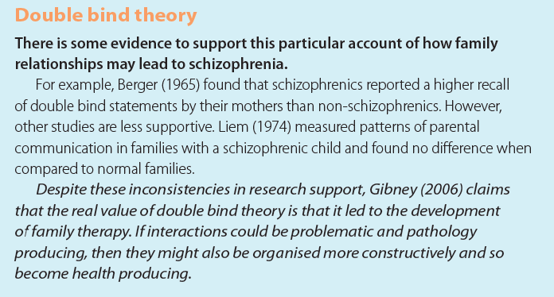
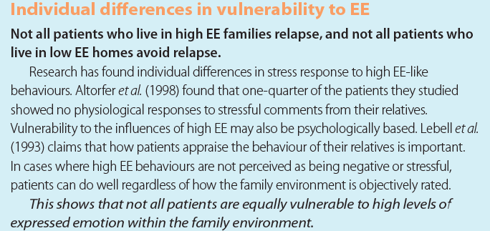
This experience leads to ________________________________________________________ ________________________________________________________________________________________________________________________________________________________ Expressed emotion is a family communication style which is characterised by ______________ ____________________________________________________________________________ ____________________________________________________________________________ There is research support for the idea that family relationships are involved in the development of schizophrenia. For example, ___________________________________________________ ________________________________________________________________________________________________________________________________________________________ ____________________________________________________________________________ One strength of double bind theory is that there is research support from __________________ ________________________________________________________________________________________________________________________________________________________________________________________________________________________________________________________________________________________________________________ One limitation of the expressed emotion explanation is that schizophrenics differ in their vulnerability to the influence of high expressed emotion._______________________________ ________________________________________________________________________________________________________________________________________________________________________________________________________________________________________________________________________________________________________________
You may need to refer to this evidence in the answer above.

Slide 26
5 | Outline and evaluate cognitive explanations of schizophrenia. | 8 marks (AO1 = 3; AO3 = 5)
Cognitive explanations claim that schizophrenia is a result of dysfunctional thought processing __________________________________________________________________________________________________________________________________________________________ __________________________________________________________________________________________________________________________________________________________ __________________________________________________________________________________________________________________________________________________________ __________________________________________________________________________________________________________________________________________________________ __________________________________________________________________________________________________________________________________________________________ One strength of cognitive explanations for schizophrenia is that there is research support from __________________________________________________________________________________________________________________________________________________________ __________________________________________________________________________________________________________________________________________________________ _____________________________________________________________________________ A criticism of cognitive explanations for schizophrenia is ________________________________ __________________________________________________________________________________________________________________________________________________________ __________________________________________________________________________________________________________________________________________________________ _____________________________________________________________________________ Another strength of cognitive explanations of schizophrenia is that ________________________ __________________________________________________________________________________________________________________________________________________________ __________________________________________________________________________________________________________________________________________________________ _____________________________________________________________________________

Slide 27
6
COGNITIVE BEHAVIOURAL THERAPY (CBTp)
What the spec says… Cognitive behaviour therapy as a treatment of schizophrenia.
1 | Which one of the following is true about cognitive behavioural therapy as a treatment for schizophrenia? Tick one box only. | 1 mark (AO1)
A | Cognitive behaviour therapy is never used with other therapies in the treatment of schizophrenia.
B | Cognitive behaviour therapy can only be used as part of group therapy.
C | Cognitive behaviour therapy only focuses on the negative symptoms of schizophrenia.
D | Cognitive behaviour therapy aims to change the maladaptive thoughts and beliefs that occur in schizophrenia.
2 | Explain how cognitive behaviour therapy can be used as a way of treating schizophrenia. | 6 marks (AO1)
CBTp focuses on ______________________________________________________________ ____________________________________________________________________________ ________________________________________________________________________________________________________________________________________________________ It does this by disputing irrational thoughts and beliefs. For example ______________________ ____________________________________________________________________________ ____________________________________________________________________________ ____________________________________________________________________________ Clients might be encouraged to ___________________________________________________ ____________________________________________________________________________ ____________________________________________________________________________ ____________________________________________________________________________ During CBTp, the therapist_______________________________________________________ ____________________________________________________________________________ ____________________________________________________________________________ ____________________________________________________________________________

Slide 28
RESEARCH METHODS ALERT
3 | In a study looking at the effectiveness of cognitive behaviour therapy, a researcher investigated the relationship between how many ‘behavioural assignments’ as therapist set a schizophrenic during treatment and the therapist’s rating of the schizophrenic’s general level of functioning. The researcher predicted there would be a positive correlation between the number of assignments and the general level of functioning. Ten therapists and ten schizophrenics were studied, and a correlation of +0.449 was found.
Was the researcher’s hypothesis directional or non-directional? Explain your answer. ____________________________________________________________________________________________________________________ __________________________________________________________ |  | 2 marks (AO2)
(b) The researcher reported a positive correlation between the two variables. Explain the difference between a positive and a negative correlation. ____________________________________________________________________________________________________________________ __________________________________________________________ __________________________________________________________ |  | 2 marks (AO1)
(c) Suggest one way in which the researcher might have displayed the correlation in graphical form. __________________________________________________________ |  | 1 mark (AO2)
(d) The researcher’s data is quantitative. What is meant by quantitative data, and how does this differ from qualitative data? ____________________________________________________________________________________________________________________ __________________________________________________________ ____________________________________________________________________________________________________________________ __________________________________________________________ |  | 3 marks (AO1)

Slide 29
(e) The researcher decided to analyse her data using a Spearman’s rho test. Using the information in the table below, state whether or not the correlation is significant at the 0.05 level of significance. Justify your answer. __________________________________________________________ __________________________________________________________ __________________________________________________________ __________________________________________________________ __________________________________________________________ __________________________________________________________ | 3 marks (AO2)
Level of significance for a two-tailed test | 0.10 | 0.05
Level of significance for a one-tailed test | 0.05 | 0.025
N = 10 | 0.564 | 0.648
N = 20 | 0.380 | 0.447
The calculated value must be EQUAL TO or GREATER THAN the tabled value for significance at the level shown.
4 | Discuss the use of cognitive behaviour therapy as a therapy for schizophrenia. | 16 marks (AO1 = 6; AO3 = 10)
The suggested paragraph starters below will help form your answer: Cognitive behaviour therapy for schizophrenia (CBTp) aims to … (AO1) CBTp has various phases, including… (AO1) For example, clients might be asked to … (AO1) One strength with CBTp as a therapy for schizophrenia is that there is supporting evidence for its effectiveness from … (AO3) However, it is difficult to assess how effective it is. For example … (AO3) Furthermore, the appropriateness and effectiveness of CBTp seems to depend on the stage of a schizophrenic’s disorder… (AO3) Another issue with CBTp is that despite its effectiveness, there is a lack of availability… (AO3) (Don’t forget to include your own evaluation points) ________________________________________________________________________________________________________________________________________________________________________ ________________________________________________________________________________________________________________________________________________________________________ ____________________________________________________________________________________ ________________________________________________________________________________________________________________________________________________________________________

Slide 30
______________________________________________________________________________________________________________________________________________________________________ ______________________________________________________________________________________________________________________________________________________________________ ___________________________________________________________________________________ ______________________________________________________________________________________________________________________________________________________________________ ______________________________________________________________________________________________________________________________________________________________________ ___________________________________________________________________________________ ______________________________________________________________________________________________________________________________________________________________________ ______________________________________________________________________________________________________________________________________________________________________ ___________________________________________________________________________________ ______________________________________________________________________________________________________________________________________________________________________ ______________________________________________________________________________________________________________________________________________________________________ ___________________________________________________________________________________ ______________________________________________________________________________________________________________________________________________________________________ ______________________________________________________________________________________________________________________________________________________________________ ___________________________________________________________________________________ ______________________________________________________________________________________________________________________________________________________________________ ______________________________________________________________________________________________________________________________________________________________________ ___________________________________________________________________________________ ______________________________________________________________________________________________________________________________________________________________________ ______________________________________________________________________________________________________________________________________________________________________

Slide 31
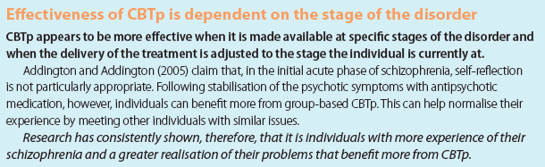
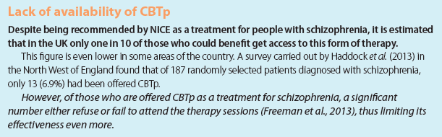
______________________________________________________________________________________________________________________________________________________________________ ______________________________________________________________________________________________________________________________________________________________________ ___________________________________________________________________________________ ______________________________________________________________________________________________________________________________________________________________________ ______________________________________________________________________________________________________________________________________________________________________ ___________________________________________________________________________________ ______________________________________________________________________________________________________________________________________________________________________ ______________________________________________________________________________________________________________________________________________________________________ ___________________________________________________________________________________ ______________________________________________________________________________________________________________________________________________________________________ ______________________________________________________________________________________________________________________________________________________________________ ___________________________________________________________________________________ ______________________________________________________________________________________________________________________________________________________________________ ______________________________________________________________________________________________________________________________________________________________________ ___________________________________________________________________________________ ______________________________________________________________________________________________________________________________________________________________________ ___________________________________________________________________________________

Slide 32
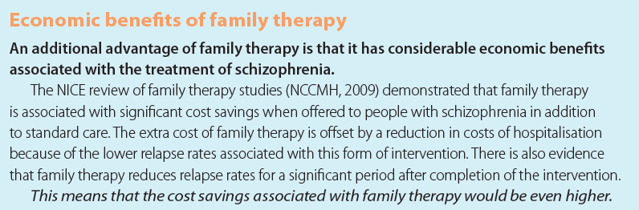
7
FAMILY THERAPY
What the spec says… Family therapy as used in the treatment of schizophrenia.
1 | Which one of the following is a feature of family therapy as used in the treatment of schizophrenia? Tick one box only. | 1 mark (AO1)
A | Using strategies to decrease expressed emotions by family members.
B | Encouraging the schizophrenic to listen to complaints from family members.
C | Using daily reports from family members to make judgements about the schizophrenic.
D | Using strategies to increase expressed emotions by family members.
2 | Evaluate family therapy as a way to treat schizophrenia. | 4 marks (AO3)
One strength of family therapy is _________________________________________________ ____________________________________________________________________________ For example, the NICE review found ______________________________________________ ____________________________________________________________________________ The initial cost is offset _________________________________________________________ ____________________________________________________________________________ This means that _______________________________________________________________ ____________________________________________________________________________ Use the information below to help you answer this question.
Tip: if a question asks you to evaluate for 4 marks, you can choose to make one evaluation point in detail, or two evaluation points in less detail. The answer above is one evaluation point.

Slide 33
RESEARCH METHODS ALERT
3 | A meta-analysis of studies of family therapy concluded that family therapy is effective in improving clinical outcomes for individuals with schizophrenia. This led to the claim, that family therapy has considerable economic benefits associated with the treatment of schizophrenia.
What is meant by a ‘meta-analysis’? ____________________________________________________________________________________________________________________ __________________________________________________________ __________________________________________________________ |  | 2 marks (AO1)
(b) Give one strength and one limitation of meta-analysis. ____________________________________________________________________________________________________________________ __________________________________________________________ __________________________________________________________ ____________________________________________________________________________________________________________________ __________________________________________________________ __________________________________________________________ |  | 4 marks (AO3)
(c) A problem with the meta-analysis described in the item is that many of the studies used lacked random allocation to the family therapy or control conditions. What is meant by random allocation, and why is the lack of this an issue in meta-analysis? __________________________________________________________ __________________________________________________________ __________________________________________________________ __________________________________________________________ ____________________________________________________________________________________________________________________ __________________________________________________________ __________________________________________________________ |  | 4 mark (AO1 = 2; AO3 = 2)

Slide 34
(d) Explain how the findings of this meta-analysis might have implications for the economy. __________________________________________________________ ____________________________________________________________________________________________________________________ __________________________________________________________ __________________________________________________________ __________________________________________________________ | 3 marks (AO2)
4 | A researcher wanted to study family therapy and drug therapy as treatments for schizophrenia. He looked at the therapies in terms of how successful they were in reducing symptoms and how costly they were to health providers. He judged drug therapy to be more effective in terms of behaviour change, but family therapy to be more effective in terms of cost. Outline one other factor the researcher could have used to compare family therapy and drug therapy, and suggest a conclusion that he might have drawn. | 4 marks (AO2)
One factor is _________________________________________________________________ ____________________________________________________________________________ For example, family therapy _____________________________________________________ ____________________________________________________________________________ However, with drug therapy _____________________________________________________ ____________________________________________________________________________ This suggests that _____________________________________________________________ ____________________________________________________________________________
5 | Outline family therapy as a way to treat schizophrenia and give one limitation of this treatment method. | 6 marks (AO1 = 3; AO3 = 3)
Family therapy aims to __________________________________________________________ ____________________________________________________________________________ ____________________________________________________________________________ Continued on next page

Slide 35
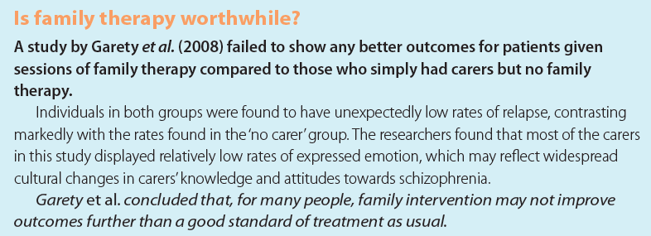
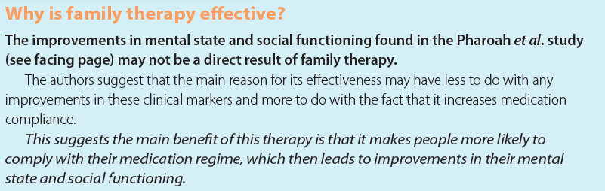
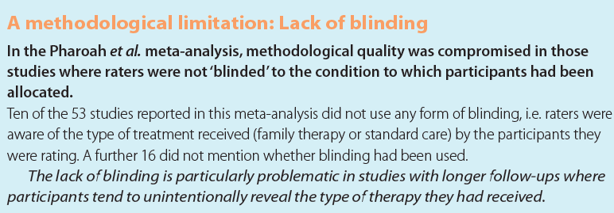
It does this by ________________________________________________________________ ________________________________________________________________________________________________________________________________________________________ One limitation of family therapy is that _____________________________________________ ____________________________________________________________________________ For example, Gareth et al found no difference between _______________________________ ____________________________________________________________________________ Garety et al concluded that ______________________________________________________ ________________________________________________________________________________________________________________________________________________________ Use the evidence to answer the question
6 | Outline and evaluate family therapy as a way of treating schizophrenia. | 16 marks (AO1 = 6; AO3 = 10)
The suggested paragraph starters below will help form your answer: Family therapy aims to … (AO1) It does this by … (AO1) Family therapy also provides family members with … (AO1) There is supporting evidence for the effectiveness of family therapy from… (AO3) Another strength of family therapy for schizophrenia is that it has been shown to have a positive impact on family members, as well as on the person with schizophrenia … (AO3) Another strength is that there are economic benefits to family therapy… (AO3) However, …. (AO3) (see below) ______________________________________________________________________________________________________________________________________________________________________ ___________________________________________________________________________________

Slide 36
______________________________________________________________________________________________________________________________________________________________________ ______________________________________________________________________________________________________________________________________________________________________ ___________________________________________________________________________________ ______________________________________________________________________________________________________________________________________________________________________ ______________________________________________________________________________________________________________________________________________________________________ ___________________________________________________________________________________ ______________________________________________________________________________________________________________________________________________________________________ ______________________________________________________________________________________________________________________________________________________________________ ___________________________________________________________________________________ ______________________________________________________________________________________________________________________________________________________________________ ______________________________________________________________________________________________________________________________________________________________________ ___________________________________________________________________________________ ______________________________________________________________________________________________________________________________________________________________________ ______________________________________________________________________________________________________________________________________________________________________ ___________________________________________________________________________________ ______________________________________________________________________________________________________________________________________________________________________ ______________________________________________________________________________________________________________________________________________________________________ ___________________________________________________________________________________ ______________________________________________________________________________________________________________________________________________________________________ ______________________________________________________________________________________________________________________________________________________________________

Slide 37
______________________________________________________________________________________________________________________________________________________________________ ______________________________________________________________________________________________________________________________________________________________________ ___________________________________________________________________________________ ______________________________________________________________________________________________________________________________________________________________________ ______________________________________________________________________________________________________________________________________________________________________ ___________________________________________________________________________________ ______________________________________________________________________________________________________________________________________________________________________ ______________________________________________________________________________________________________________________________________________________________________ ___________________________________________________________________________________ ______________________________________________________________________________________________________________________________________________________________________ ______________________________________________________________________________________________________________________________________________________________________ ___________________________________________________________________________________ ______________________________________________________________________________________________________________________________________________________________________ ______________________________________________________________________________________________________________________________________________________________________ ___________________________________________________________________________________ ______________________________________________________________________________________________________________________________________________________________________ ______________________________________________________________________________________________________________________________________________________________________ ___________________________________________________________________________________ ______________________________________________________________________________________________________________________________________________________________________ ______________________________________________________________________________________________________________________________________________________________________

Slide 38
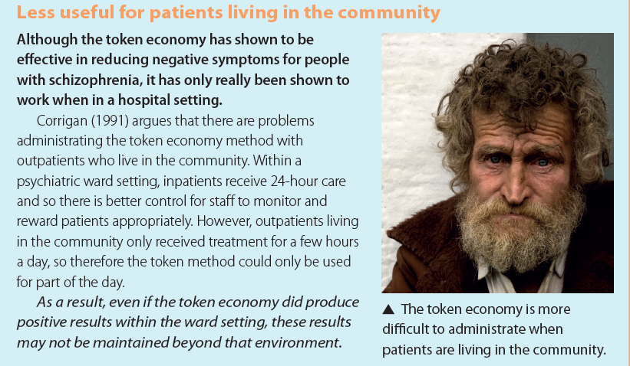
8
TOKEN ECONOMY AND THE MANAGEMENT OF SCHIZOPHRENIA
What the spec says… Token economies as used in the management of schizophrenia
1 | Which one of the following statements about token economies is true? Tick one box only. | 1 mark (AO1)
A | There are no ethical issues associated with token economies.
B | Token economies lead to permanent behavioural changes.
C | Token economies use negative reinforcement to change behaviour.
D | Token economies use both primary and secondary reinforcers.
2 | Explain one limitation of token economies as a way to manage schizophrenia. | 4 marks (AO3)
One limitation of token economies is_______________________________________________ ____________________________________________________________________________ For example, Corrigan argues that ________________________________________________ ____________________________________________________________________________ In a psychiatric setting __________________________________________________________ ____________________________________________________________________________ However, outpatients ___________________________________________________________ ____________________________________________________________________________ This means that _______________________________________________________________ ____________________________________________________________________________ Use the information below to help you answer this question.

Slide 39
RESEARCH METHODS ALERT
3 | In a study looking at the effectiveness of token economies, researchers asked two independent observers to record the activity levels of twelve chronic schizophrenics on a hospital ward. Measurements were taken before the token economy programme was implemented and six months after its implementation. The researchers found an increase in activity levels which was significant at p<0.05.
Identify the sampling method used by researchers. __________________________________________________________ |  | 1 marks (AO2)
(b) Explain one disadvantage of the sampling method you identified in question (a). ____________________________________________________________________________________________________________________ __________________________________________________________ __________________________________________________________ |  | 2 marks (AO3)
(c) Explain one way in which the researchers could have recoded the behavioural categories associated with ‘activity levels’. __________________________________________________________ __________________________________________________________ __________________________________________________________ __________________________________________________________ |  | 2 marks (AO2)
(d) Explain one way in which the researchers could have assessed how reliable the observers were. __________________________________________________________ __________________________________________________________ __________________________________________________________ __________________________________________________________ __________________________________________________________ __________________________________________________________ __________________________________________________________ __________________________________________________________ |  | 4 marks (AO2)

Slide 40
(e) The researchers found that the increase in activity levels was significant at p<0.05. What is meant by ‘significant at p<0.05’? __________________________________________________________ ____________________________________________________________________________________________________________________ __________________________________________________________ | 2 marks (AO1)
4 | Outline the token economy as used in the management of schizophrenia and give one strength of this method of treatment. | 6 marks (AO1 = 3; AO3 = 3)
The token economy system aims to ________________________________________________ _____________________________________________________________________________ It works by ___________________________________________________________________ ____________________________________________________________________________ ____________________________________________________________________________ One strength of the token economy is _____________________________________________ ____________________________________________________________________________ ____________________________________________________________________________ For example, Glowacki et al______________________________________________________ ____________________________________________________________________________ ____________________________________________________________________________ ____________________________________________________________________________ ____________________________________________________________________________
5 | Outline and evaluate the token economy as a way of managing schizophrenia. | 16 marks (AO1 = 6; AO3 = 10)
The suggested paragraph starters below will help form your answer: The token economy system is based on… (AO1) It aims to… (AO1) It involves… (AO1) One strength of the token economy is that it seems to be effective in managing schizophrenic behaviour… (AO3) Continued on next page

Slide 41
However, an issue with this evidence is … (AO3) Furthermore, token economies raise certain ethical issues… (AO3) Additionally….(AO3) (don’t forget to add your own points!) ______________________________________________________________________________________________________________________________________________________________________ ______________________________________________________________________________________________________________________________________________________________________ ___________________________________________________________________________________ ______________________________________________________________________________________________________________________________________________________________________ ______________________________________________________________________________________________________________________________________________________________________ ___________________________________________________________________________________ ______________________________________________________________________________________________________________________________________________________________________ ______________________________________________________________________________________________________________________________________________________________________ ___________________________________________________________________________________ ______________________________________________________________________________________________________________________________________________________________________ ______________________________________________________________________________________________________________________________________________________________________ ___________________________________________________________________________________ ______________________________________________________________________________________________________________________________________________________________________ ______________________________________________________________________________________________________________________________________________________________________ ___________________________________________________________________________________ ______________________________________________________________________________________________________________________________________________________________________ ______________________________________________________________________________________________________________________________________________________________________ ______________________________________________________________________________________________________________________________________________________________________

Slide 42
______________________________________________________________________________________________________________________________________________________________________ ______________________________________________________________________________________________________________________________________________________________________ ___________________________________________________________________________________ ______________________________________________________________________________________________________________________________________________________________________ ______________________________________________________________________________________________________________________________________________________________________ ___________________________________________________________________________________ ______________________________________________________________________________________________________________________________________________________________________ ______________________________________________________________________________________________________________________________________________________________________ ___________________________________________________________________________________ ______________________________________________________________________________________________________________________________________________________________________ ______________________________________________________________________________________________________________________________________________________________________ ___________________________________________________________________________________ ______________________________________________________________________________________________________________________________________________________________________ ______________________________________________________________________________________________________________________________________________________________________ ___________________________________________________________________________________ ______________________________________________________________________________________________________________________________________________________________________ ______________________________________________________________________________________________________________________________________________________________________ ___________________________________________________________________________________ ______________________________________________________________________________________________________________________________________________________________________ ______________________________________________________________________________________________________________________________________________________________________

Slide 43
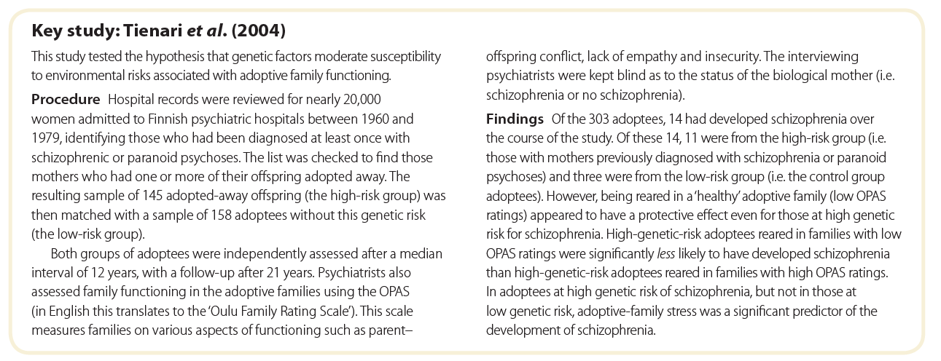
9
AN INTERACTIONIST APPROACH
What the spec says… The importance of an interactionist approach in explaining and treating schizophrenia; the diathesis-stress model.
1 | Which one of the following statements about the diathesis-stress model is true? Tick one box only. | 1 mark (AO1)
A | People who have a high biological vulnerability to schizophrenia always develop the disorder irrespective of stress factors.
B | People who have a low biological vulnerability to schizophrenia never develop the disorder irrespective of stress factors.
C | People with a high biological vulnerability to schizophrenia are less likely to develop the disorder when they experience increases in stress.
D | People with a low biological vulnerability to schizophrenia are more likely to develop the disorder when they experience increases in stress.
2 | Explain the diathesis-stress model of schizophrenia. | 4 marks (AO1)
The diathesis-stress model of schizophrenia is the result of _____________________________ ____________________________________________________________________________ A diathesis is _________________________________________________________________ ____________________________________________________________________________ Stress is _____________________________________________________________________ ____________________________________________________________________________ A combination of ______________________________________________________________ ____________________________________________________________________________
3 | Outline one study that has explored the diathesis-stress model of schizophrenia. | 4 marks (AO1)

Slide 44
Tienari et al. reviewed hospital records for women admitted to psychiatric hospitals and ______ ____________________________________________________________________________ ____________________________________________________________________________ ____________________________________________________________________________ They found __________________________________________________________________ ____________________________________________________________________________ ____________________________________________________________________________ ____________________________________________________________________________ ____________________________________________________________________________
4 | James was reading a book about the causes of schizophrenia. The book claimed that genetic factors are involved in schizophrenia. ‘It can’t be genetic,’ he thought, ‘because if it was, people who have a family history of it would always develop it.’ Use your knowledge of the diathesis-stress model to explain to James why people with a genetic vulnerability to schizophrenia do not always develop the disorder. | 4 marks (AO1=2; AO2=2)
James is wrong to think that _____________________________________________________ ____________________________________________________________________________ This is because the diathesis-stress model states that _________________________________ ____________________________________________________________________________ However if there are no stressors to trigger the vulnerability then ________________________ ____________________________________________________________________________ This would explain why _________________________________________________________ ____________________________________________________________________________
5 | Discuss the interactionist approach to explaining schizophrenia. | 8 marks (AO1=3; AO3=5)
____________________________________________________________________________ ____________________________________________________________________________ ____________________________________________________________________________ ____________________________________________________________________________ Continued on next page

Slide 45
______________________________________________________________________________________________________________________________________________________________________ ______________________________________________________________________________________________________________________________________________________________________ ___________________________________________________________________________________ ______________________________________________________________________________________________________________________________________________________________________ ______________________________________________________________________________________________________________________________________________________________________ ___________________________________________________________________________________ ______________________________________________________________________________________________________________________________________________________________________ ______________________________________________________________________________________________________________________________________________________________________ ___________________________________________________________________________________ ______________________________________________________________________________________________________________________________________________________________________ ______________________________________________________________________________________________________________________________________________________________________ ___________________________________________________________________________________ ______________________________________________________________________________________________________________________________________________________________________ ______________________________________________________________________________________________________________________________________________________________________ ___________________________________________________________________________________ ______________________________________________________________________________________________________________________________________________________________________ ______________________________________________________________________________________________________________________________________________________________________ ___________________________________________________________________________________ ______________________________________________________________________________________________________________________________________________________________________ ______________________________________________________________________________________________________________________________________________________________________

Slide 46
6 | Discuss the interactionist approach to treating schizophrenia. | 8 marks (AO1=3; AO3=5)
____________________________________________________________________________ ____________________________________________________________________________ ____________________________________________________________________________ ____________________________________________________________________________ ____________________________________________________________________________ ____________________________________________________________________________ ____________________________________________________________________________ ____________________________________________________________________________ ____________________________________________________________________________ ____________________________________________________________________________ ____________________________________________________________________________ ____________________________________________________________________________ ____________________________________________________________________________ ____________________________________________________________________________ ____________________________________________________________________________ ____________________________________________________________________________ ____________________________________________________________________________ ____________________________________________________________________________ ____________________________________________________________________________ ____________________________________________________________________________ ____________________________________________________________________________ ____________________________________________________________________________ ____________________________________________________________________________ ____________________________________________________________________________ ____________________________________________________________________________ ____________________________________________________________________________ ____________________________________________________________________________ ____________________________________________________________________________ ____________________________________________________________________________

Slide 47
______________________________________________________________________________________________________________________________________________________________________ ______________________________________________________________________________________________________________________________________________________________________ ___________________________________________________________________________________ ______________________________________________________________________________________________________________________________________________________________________ ______________________________________________________________________________________________________________________________________________________________________ ___________________________________________________________________________________ ______________________________________________________________________________________________________________________________________________________________________ ______________________________________________________________________________________________________________________________________________________________________ ___________________________________________________________________________________ ______________________________________________________________________________________________________________________________________________________________________ ______________________________________________________________________________________________________________________________________________________________________ ___________________________________________________________________________________ ______________________________________________________________________________________________________________________________________________________________________
End of booklet

